Slide 1

Power
Power is the rate at which energy (or work) is expended. Absorbed power is proportional both to the current and the voltage needed to transfer one coulomb through the device. The unit of power is the .

Slide 2


Slide 3
Star to Delta and Delta to Star Transformations:
Like in series and parallel connections, electrical components may be connected in Star or Delta configurations as shown in the figure below (with Resistances). Many a times circuits have to be transformed from Star to equivalent Delta and Delta to equivalent Star configurations such that the net terminal Resistances ( Impedances)across the terminals are the same.

Slide 4
Like in series and parallel connections, electrical components may be connected in Star or Delta configurations as shown in the figure below (with Resistances). Many a times circuits have to be transformed from Star to equivalent Delta and Delta to equivalent Star configurations such that the net terminal Resistances ( Impedances)across the terminals are the same.

Slide 5
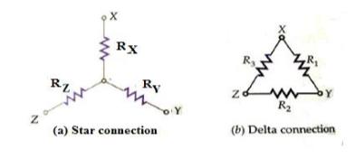

Slide 6

Delta to Star Transformation:
The circuit configurations are identical provided the net resistances across the terminal pairs XY, YZ and ZX in both connections are the same. In Star Connection they are:

Slide 7
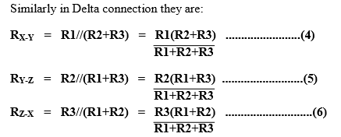

Slide 8
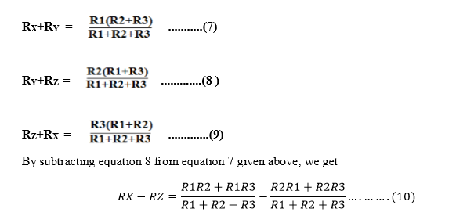
By equating the respective equations, we get

Slide 9
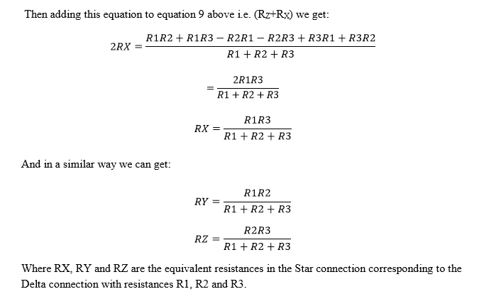

Slide 10
Star to Delta Transformation:
Now we have to get the equivalent values of R1, R2 and R3 in Delta connection in terms of the three resistances RX,RY and RZ in Star connection. Let us use the equations we got earlier i.e. RX,RY and RZ in terms of R1,R2 and R3 and get the sum of the three product pairs i.e. RXRY + RYRZ + RZRX as :

Slide 11
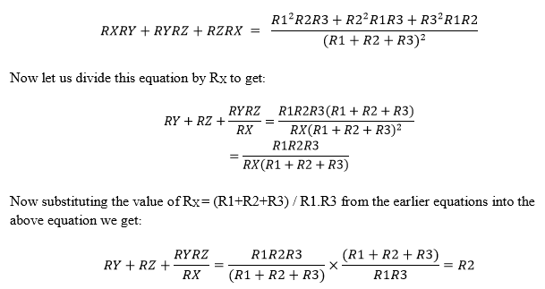

Slide 12
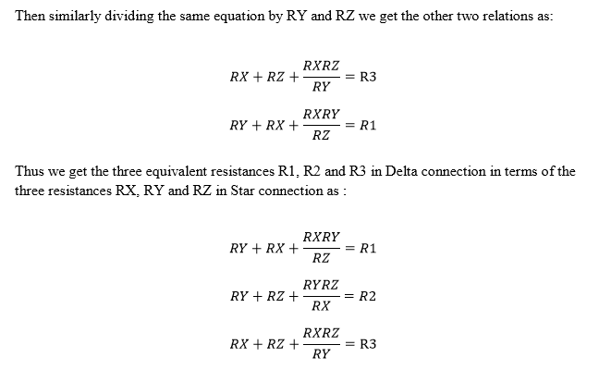

Slide 13
CIRCUIT ANALYSIS
Electric Circuit
An electric circuit is an interconnection of electrical components.

Slide 14
Elements of an Electric circuit:
An Electric circuit consists of following types of elements.
1.Active elements:
Active elements are the elements of a circuit which possess energy of their own and can impart it to other element of the circuit.

Slide 15
Active elements are of two types
a) Voltage source
b) Current source
A Voltage source has a specified voltage across its terminals, independent of current flowing through it.
A current source has a specified current through it independent of the voltage appearing across it.

Slide 16
Passive Elements:
The passive elements of an electric circuit do not possess energy of their own. They receive energy from the sources. The passive elements are the resistance, the inductance and the capacitance.

Slide 17
When electrical energy is supplied to a circuit element, it will respond in one and more of the following ways.
If the energy is consumed, then the circuit element is a pure resistor.
If the energy is stored in a magnetic field, the element is a pure inductor.
And if the energy is stored in an electric field, the element is a pure capacitor.

Slide 18
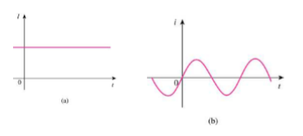
Two Important Types of Current
Direct current (DC) is a current that remains constant with time.
• Alternating current (AC) is a current that varies
sinusoidally with time.

Slide 19
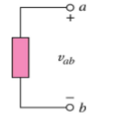
Voltage Polarity
The plus (+) and minus (-) sign are used to define voltage polarity.
• The assumption is that the potential of the terminal
with (+) polarity is higher than the potential of the
terminal with (-) polarity by the amount of voltage
drop.

Slide 20
Types of Sources:
1. Independent sources
2. Dependent sources
Dependent Source: a source whose value depends on a voltage or current elsewhere in the circuit.
Independent Source: a source whose value does is independent of any other voltages or currents in the circuit.

Slide 21
Voltage Sources: In general, there will be a current flowing through a voltage source. That current can be positive, negative, or zero, depending on how the source is connected into the circuit.
Independent Voltage Source
The independent voltage source maintains a fixed voltage across its terminals regardless of the current through it.

Slide 22
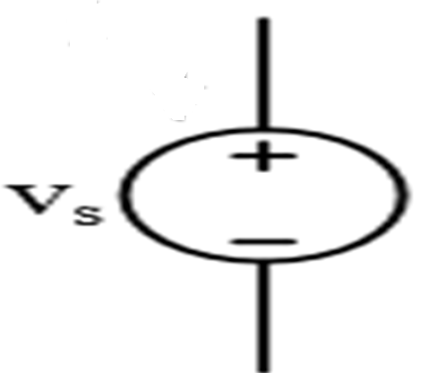

Slide 23
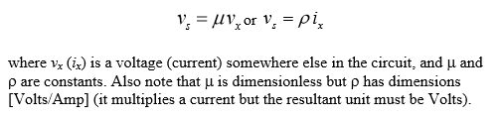
Dependent Voltage Source
The dependent (or controlled) voltage source maintains a voltage across its terminals that depends on either a voltage or current elsewhere in the circuit.

Slide 24
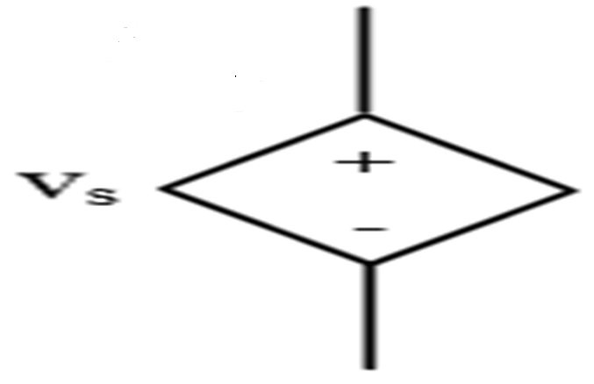

Slide 25
Current Sources: In general, there will be a voltage across a current source. That voltage can be positive, negative, or 0 depending on how it is connected into the circuit.
Independent Current Source
The ideal independent current source maintains a fixed current through its terminals regardless of the voltage across it

Slide 26
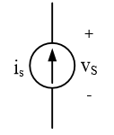

Slide 27
Dependent Current Source
The ideal dependent (or controlled) current source maintains a current through its terminals that depends on either a voltage or current elsewhere in the circuit. Thus

Slide 28



Slide 29
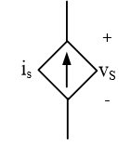

Slide 30
R-L-C Parameters:
Resistance is that property of a circuit element which opposes the flow of electric current and in doing so converts electrical energy into heat energy.
It is the proportionality factor in ohm’s law relating
voltage and current.
Ohm’s law states that the voltage drop across a conductor of given length and area of cross section is directly proportional to the current flowing through it.

Slide 31

R œ i
V=Ri

Slide 32
Where the reciprocal of resistance is called conductance G. The unit of resistance is ohm and the unit of conductance is mho or Siemens.
When current flows through any resistive material, heat is generated by the collision of electrons with other atomic particles. The power absorbed by the resistor is converted to heat and is given by the expression

Slide 33

Energy lost in a resistance in time t is given by

Slide 34
Inductance:
Inductance is the property of a material by virtue of which it opposes any change of magnitude and direction of electric current passing through conductor. A wire of certain length, when twisted into a coil becomes a basic nductor. A change in the magnitude of the current changes the electromagnetic field.

Slide 35
Increase in current expands the field & decrease in current reduces it. A change in current produces change in the electromagnetic field. This induces a voltage across the coil according to Faradays laws of Electromagnetic Induction.

Slide 36
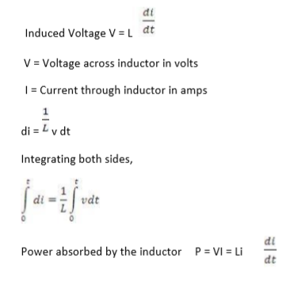

Slide 37
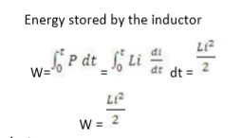

Slide 38
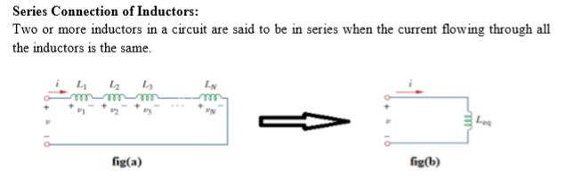


Slide 39
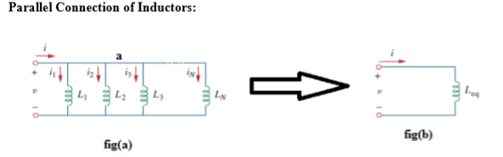

Slide 40
Capacitance:
1) A capacitor consists of two metallic surfaces or conducting surfaces separated by a dielectric medium.
2) It is a circuit element which is capable of storing electrical energy in its electric field.
3) Capacitance is its capacity to store electrical energy.
4) Capacitance is the proportionality constant relating the charge on the conducting plates to the potential.

Slide 41
Charge on the capacitor
q = CV
Where `C` is the capacitance in farads, q is charge in coulombs and V
is the potential difference across the capacitor in volts.

Slide 42
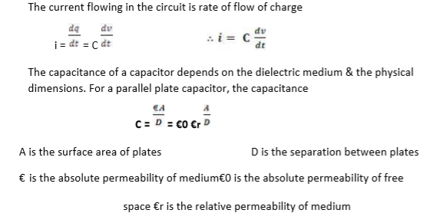

Slide 43
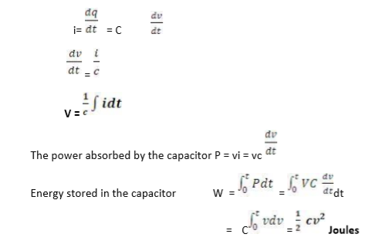

Slide 44
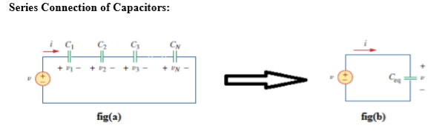


Slide 45
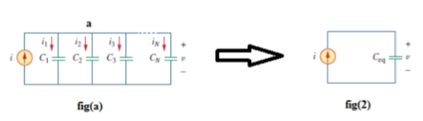
Parallel Connection of Capacitors:

Slide 46
Steady state Analysis of Series RLC circuits:
Thus far we have seen that the three basic passive components: resistance (R), inductance (L), and capacitance (C) have very different phase relationships to each other when connected to a sinusoidal AC supply.

Slide 47
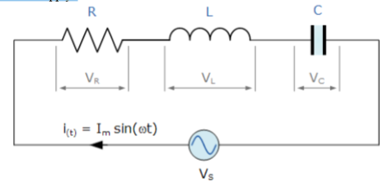

Slide 48
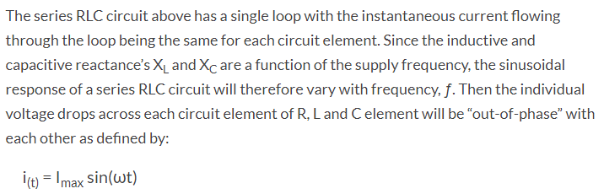

Slide 49
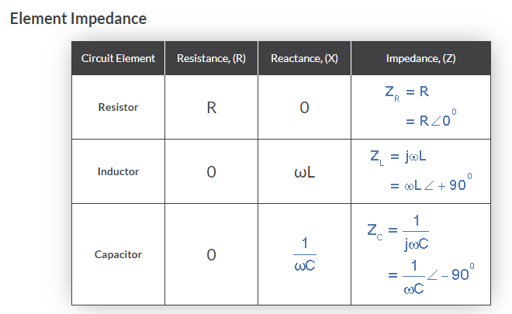

Slide 50
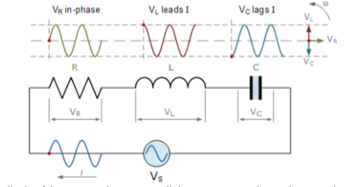

Slide 51


Slide 52
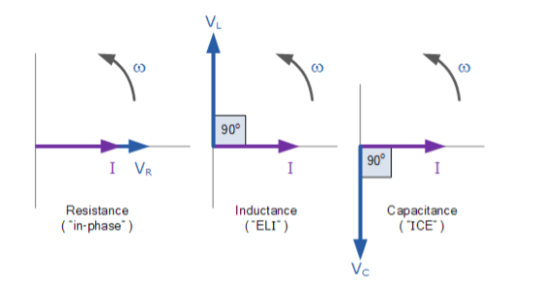
Individual Voltage Vectors

Slide 53
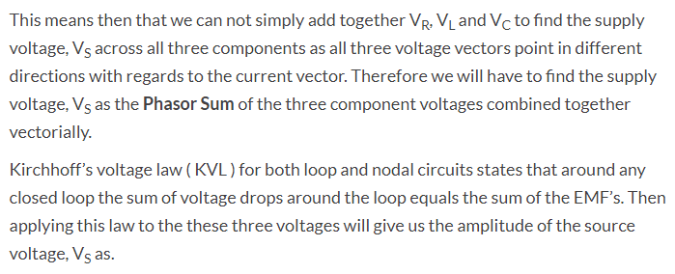
Instantaneous Voltages for a Series RLC Circuit:

Slide 54
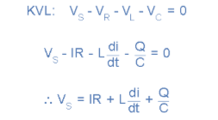

Slide 55
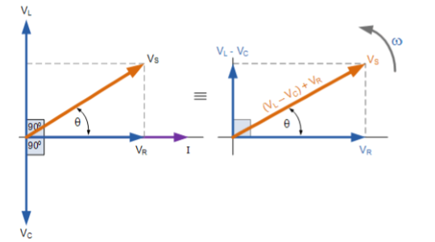
Phasor Diagram for a Series RLC Circuit:

Slide 56
We can see from the phasor diagram on the right hand side above that the voltage vectors produce a rectangular triangle, comprising of hypotenuse VS, horizontal axis VR and vertical axis VL – VC Hopefully you will notice then, that this forms our old favourite the Voltage Triangle and we can therefore use Pythagoras’s theorem on this voltage triangle to mathematically obtain the value of VS as shown.

Slide 57
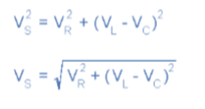
Voltage Triangle for a Series RLC Circuit:

Slide 58
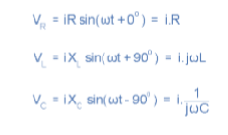

Slide 59


Slide 60
The phase angle, θ between the source voltage, VS and the current, i is the same as for the angle between Z and R in the impedance triangle. This phase angle may be positive or negative in value depending on whether the source voltage leads or lags the circuit current and can be calculated mathematically from the ohmic values of the impedance triangle as

Slide 61


